Slide 1


Slide 2

Spreadsheets are the duct tape for managing data

Slide 3

It’s a quick fix, but dangerous in the long run

Slide 4
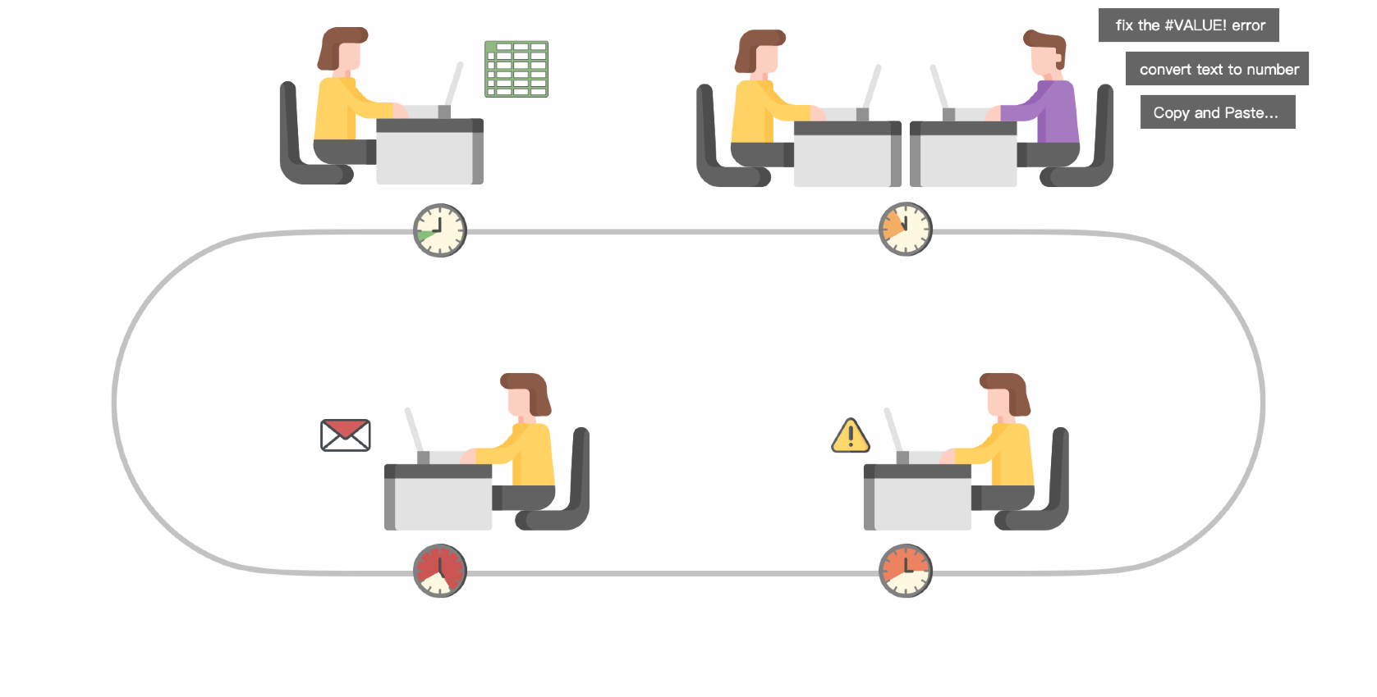
Time Sink
People can spend as much as 90% of their time
working with spreadsheets
Creating spreadsheet
Merging versions
Filling to management
Locating errors

Slide 5
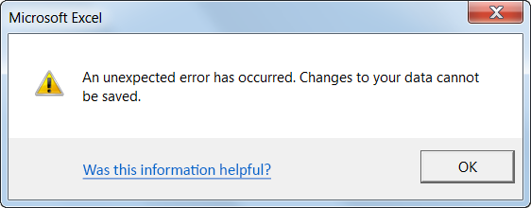
Errors
88% of all spreadsheets contain errors that are not auditable

Slide 6
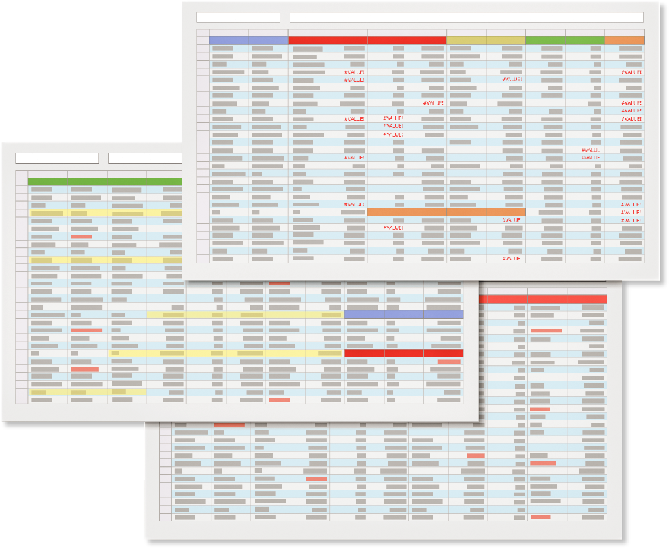
No Big Picture
Too many worksheets make it hard to visualize
how data fits together

Slide 7
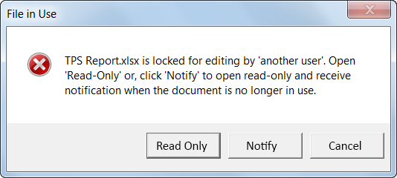
Growing Pains
As your data grows, there is no way to control its access

Slide 8

But building a database system
is even more …
frustrating

Slide 9



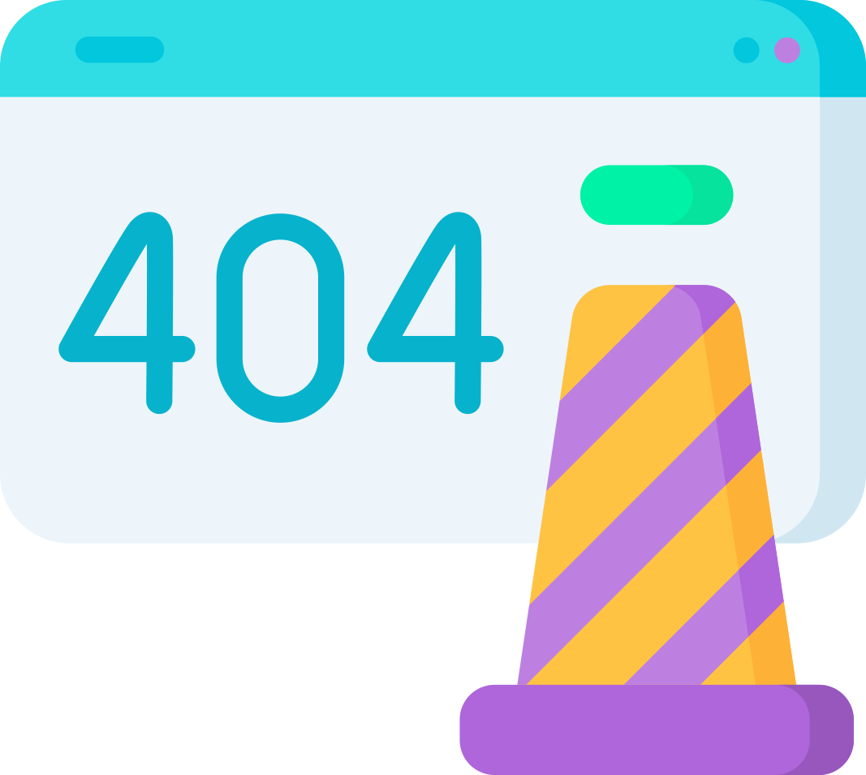
Delays
Over 90% of enterprise IT projects are delivered late

Slide 10

Failures
Over 40% of planned IT projects end up failing or unused

Slide 11
Way Too Big
Higher software complexity means more maintenance
Software Package
Your Actual
Requirements

Slide 12
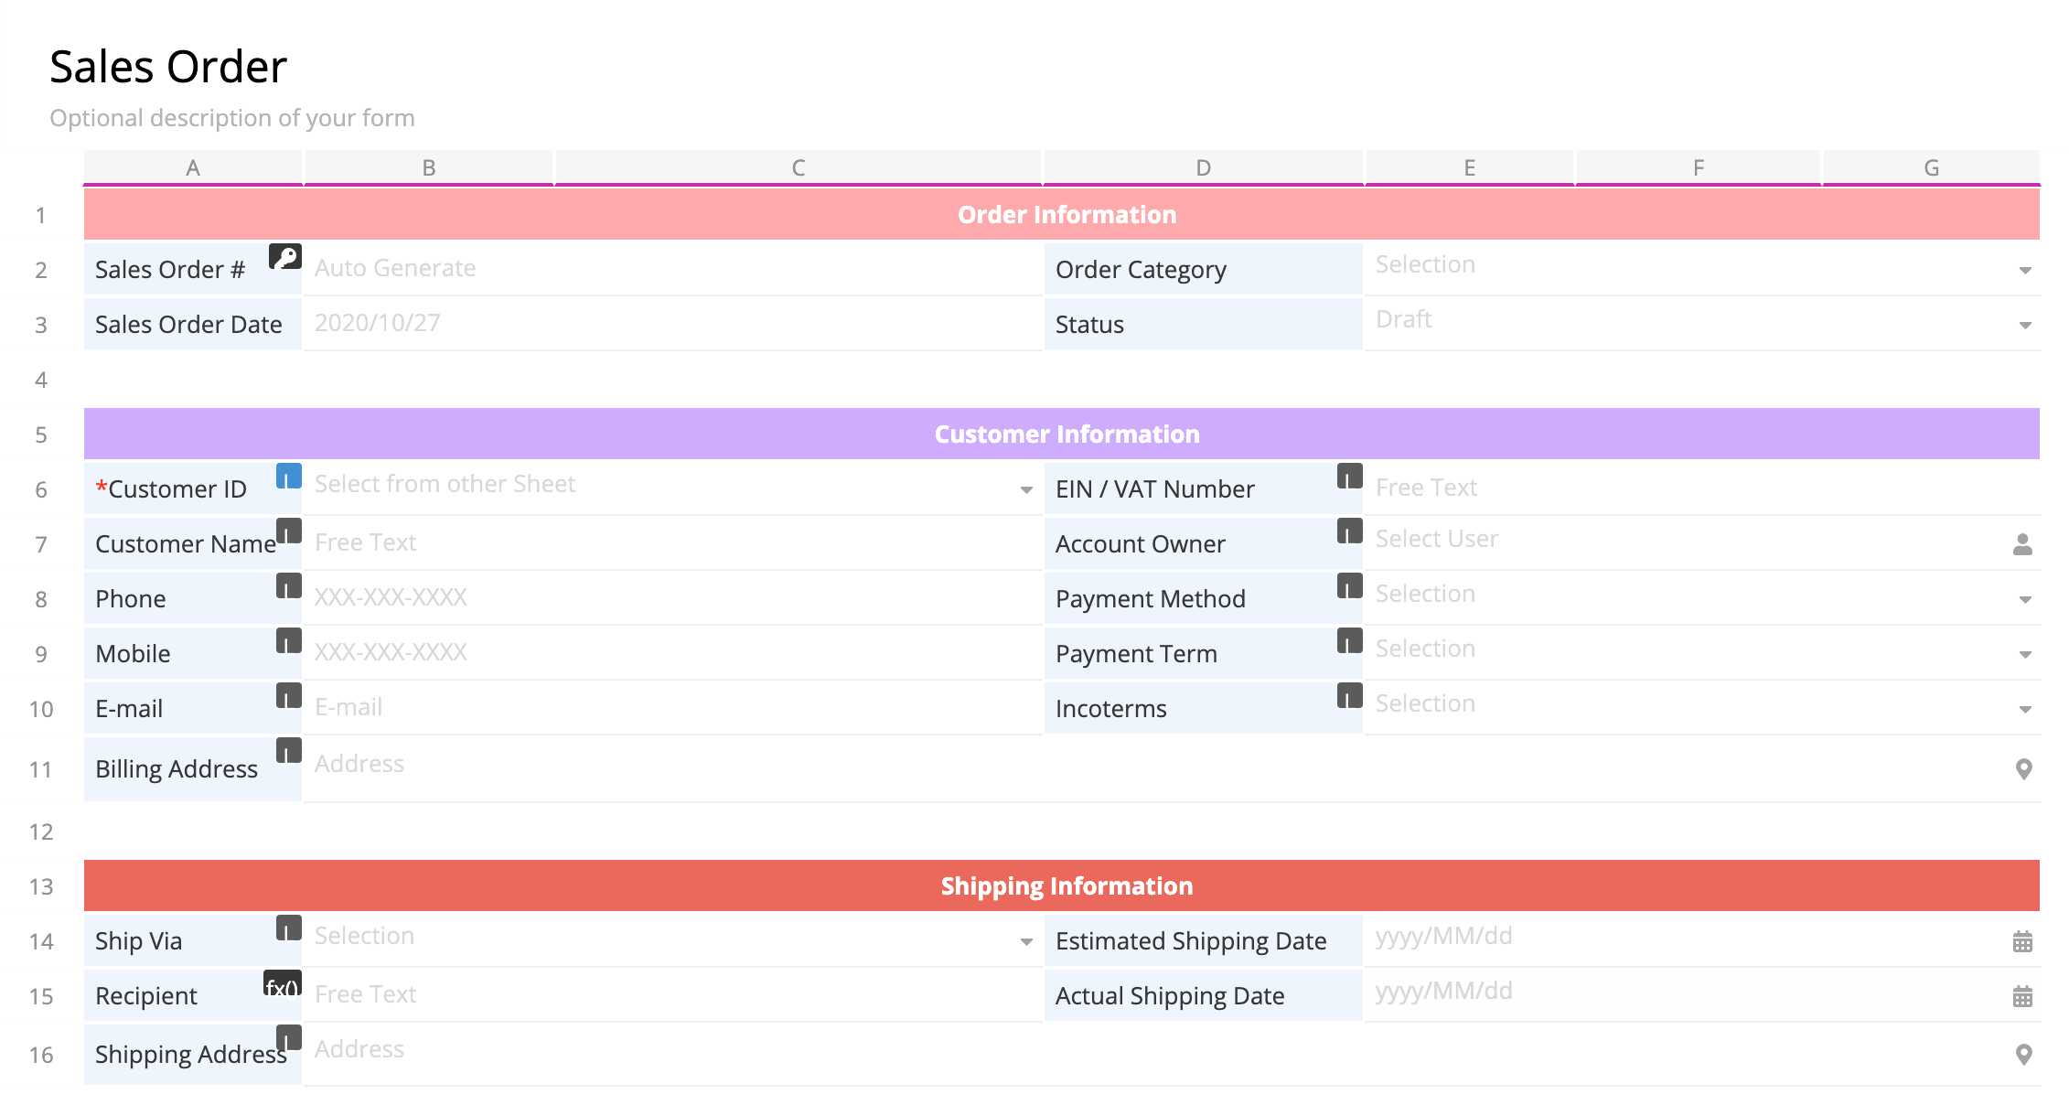
We Want to Change This
Build databases like editing spreadsheets

Slide 13






IT
Sales
PM
Developer
By putting the power of data back to people
who run the business makes good data management
a commodity to organizations of all sizes

Slide 14

What makes different?

Slide 15
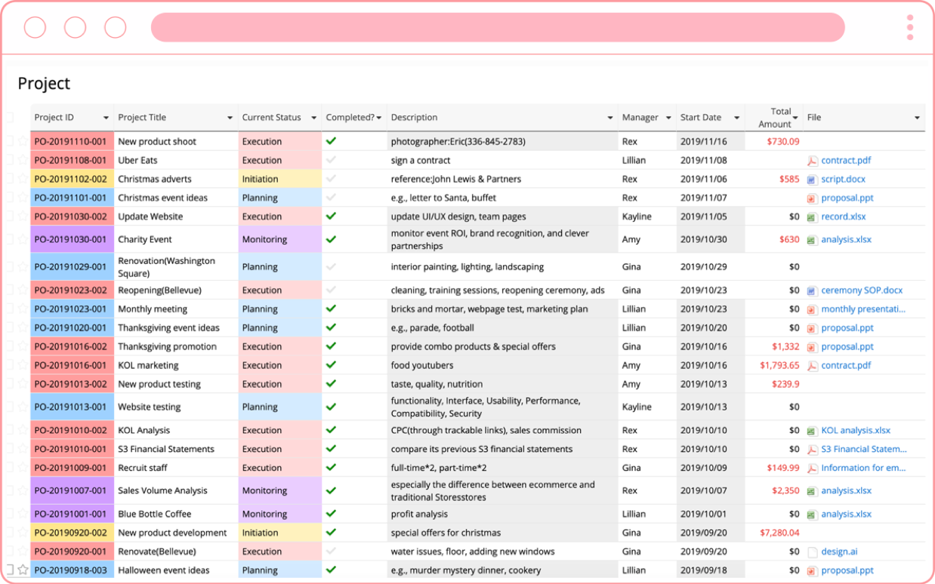

Powerful
Ragic’s unique technology takes database building to another level
SUCCESS

Slide 16
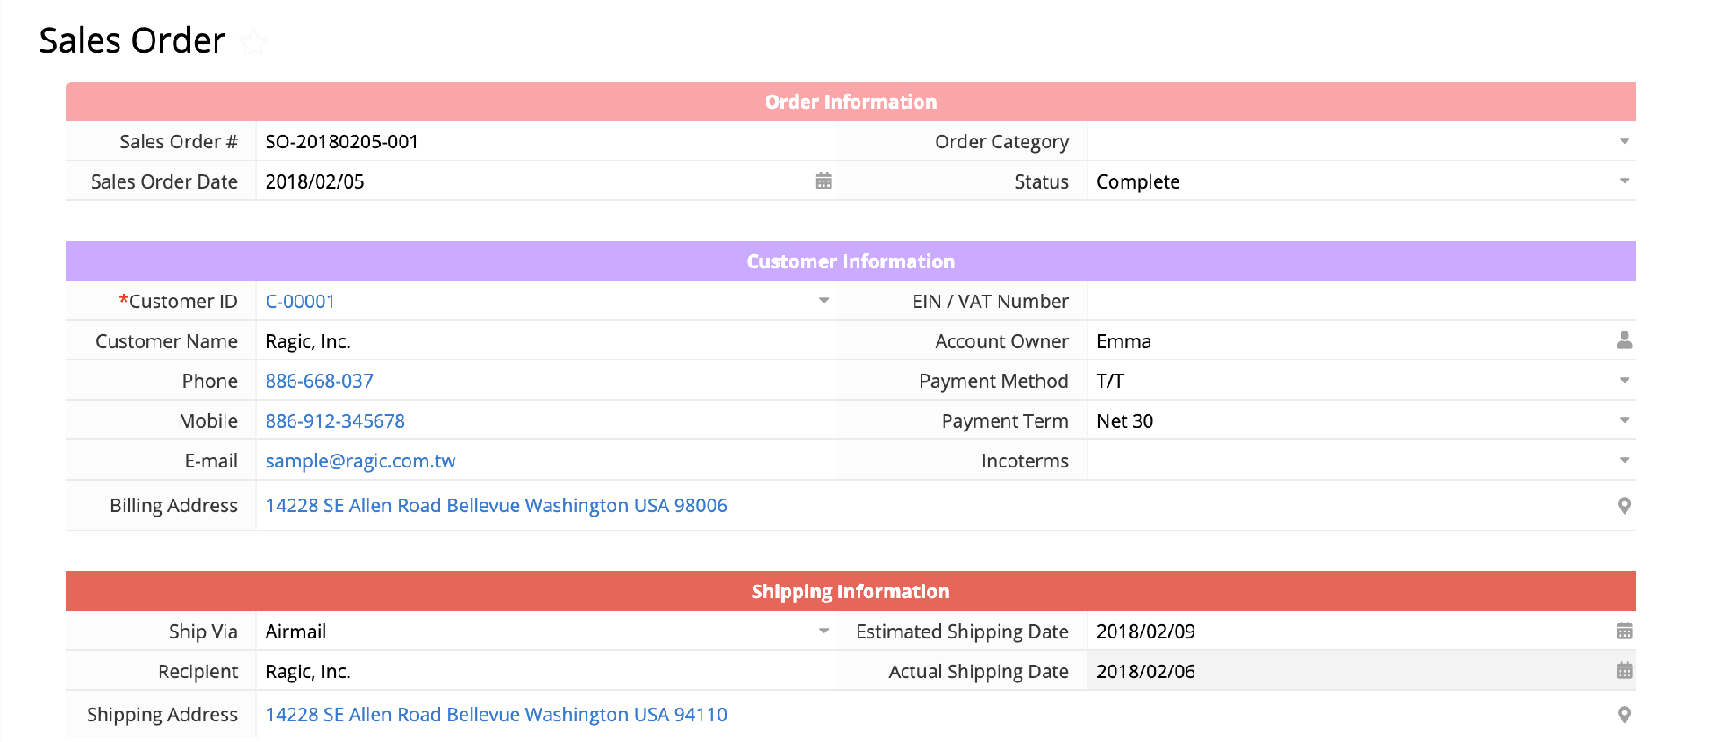
Simple
We keep database design simple,
make it as easy as creating a form on a spreadsheet

Slide 17

Your database comes with these
powerful features without a line of code

Slide 18

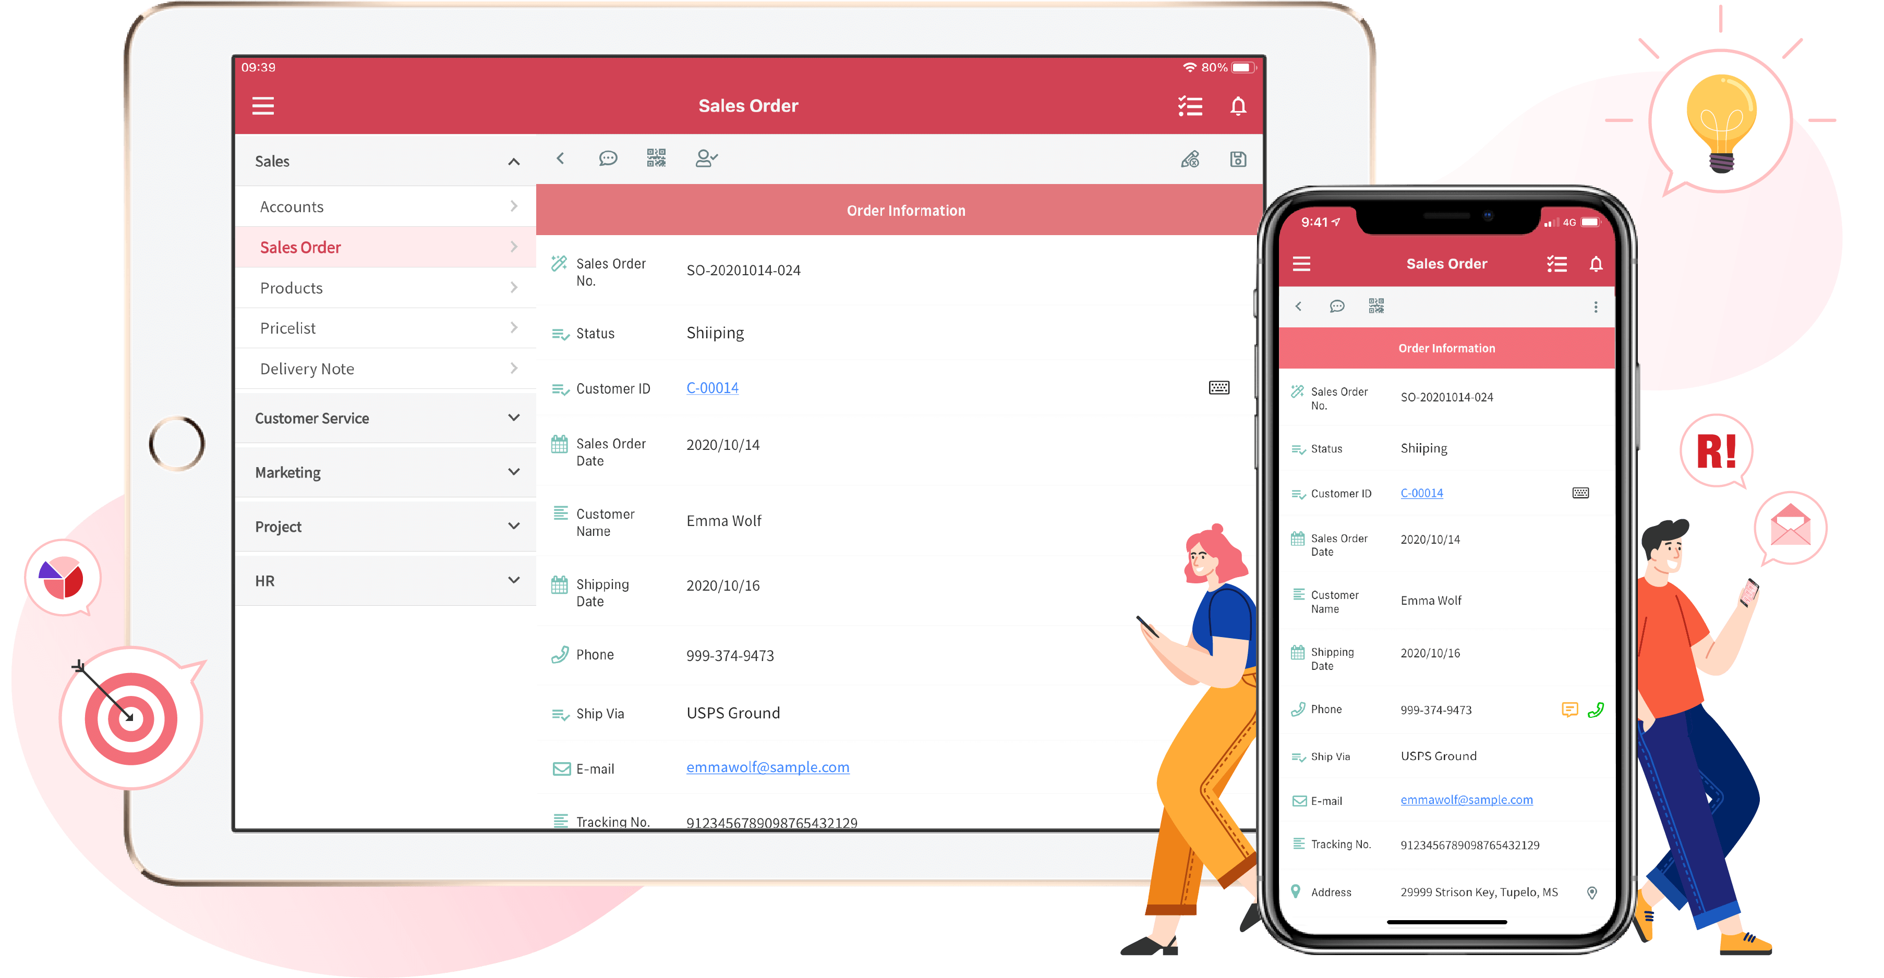
Mobile Access
View, enter, and edit records on the go

Slide 19
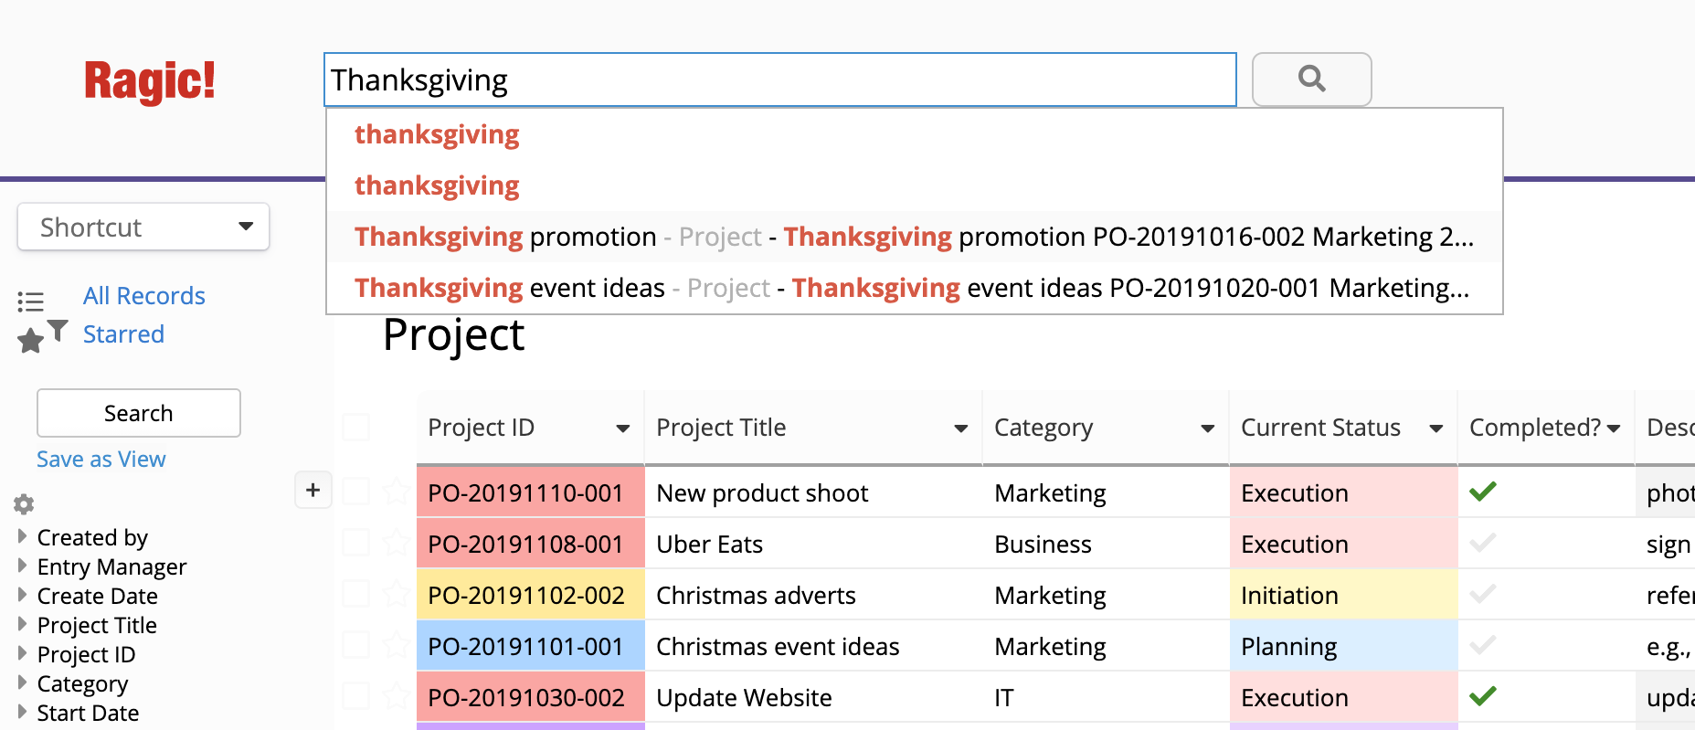
Full-Text Search
The confidence of instantly finding the data you are looking for

Slide 20
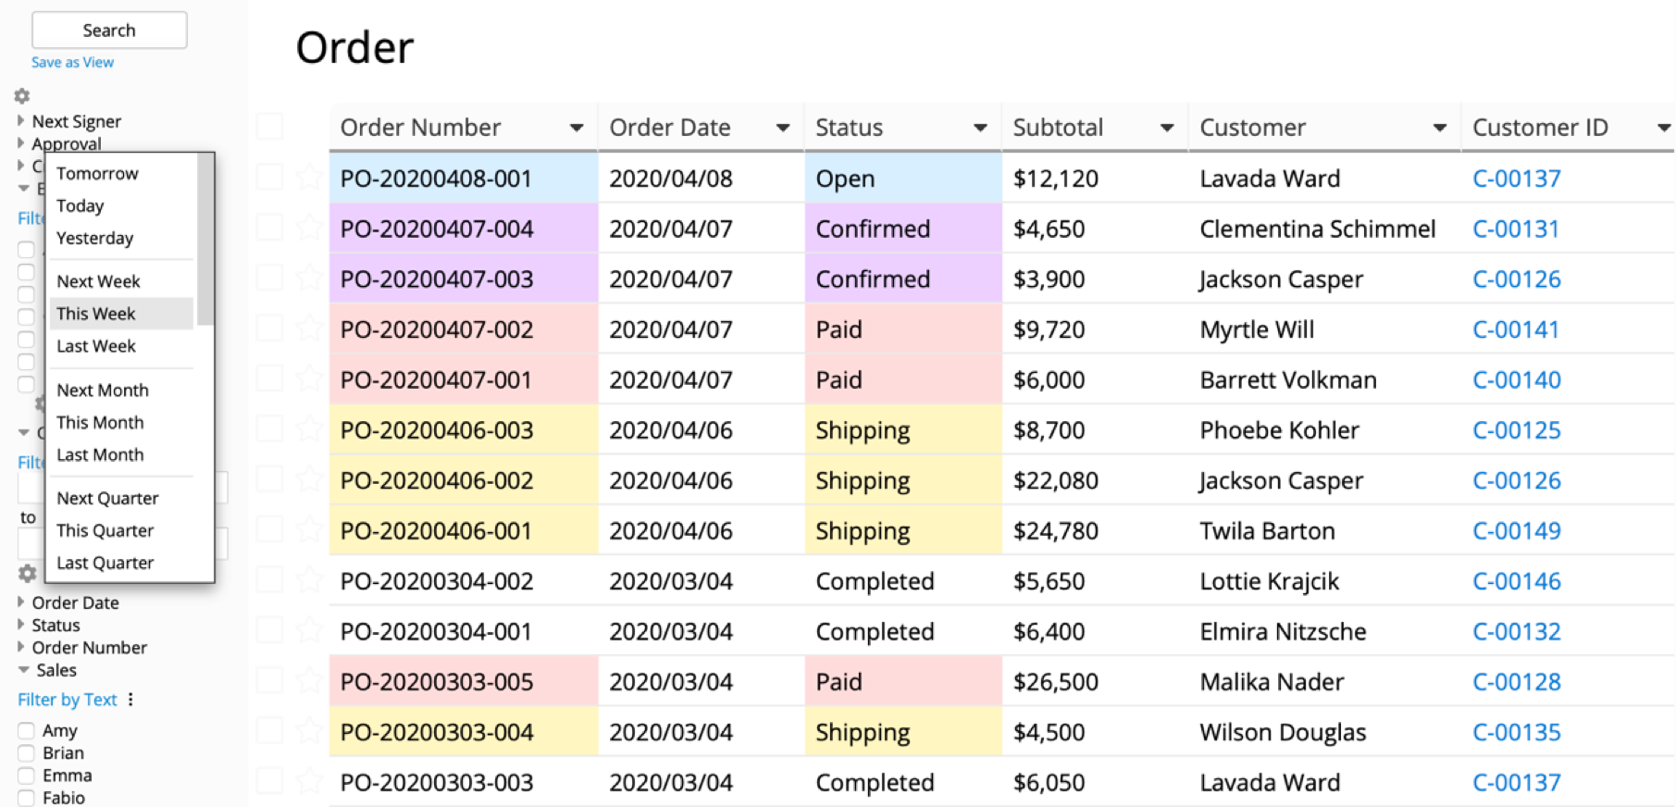
Query Builder and Data Views
Create multiple views based on query criteria on
any combination of fields

Slide 21
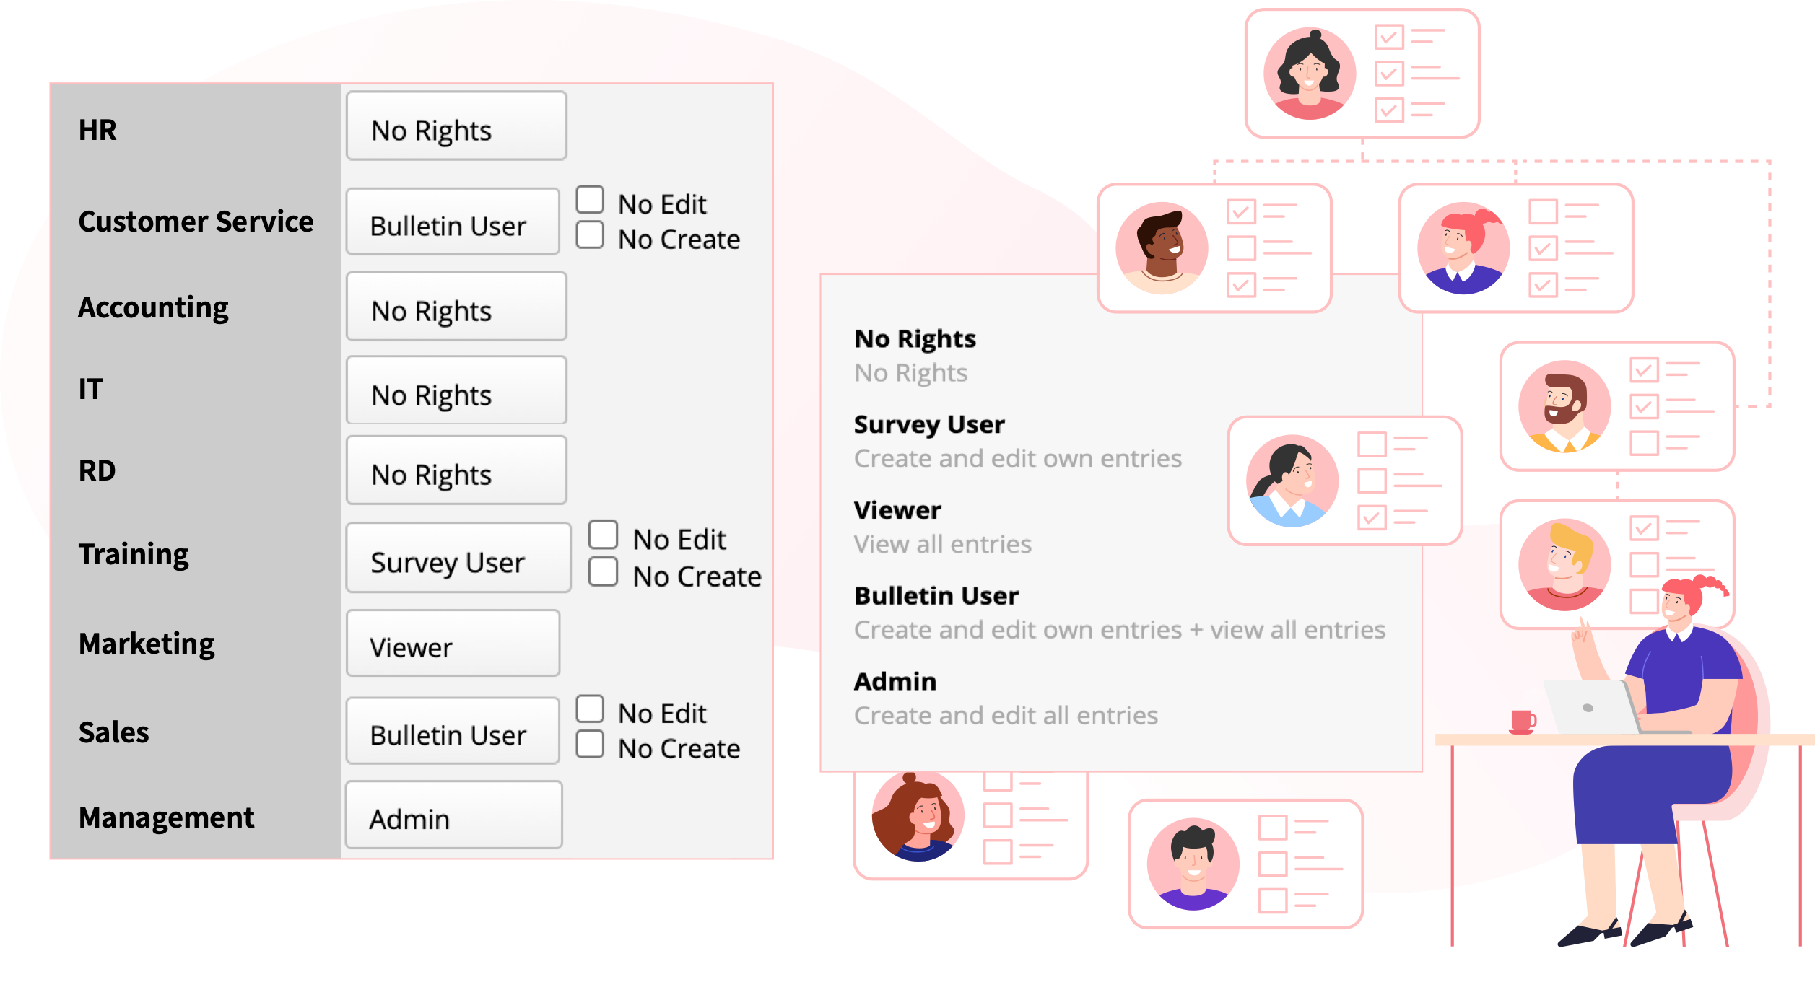
Controlled Access
You decide on who can view, edit, or create entries in your database

Slide 22
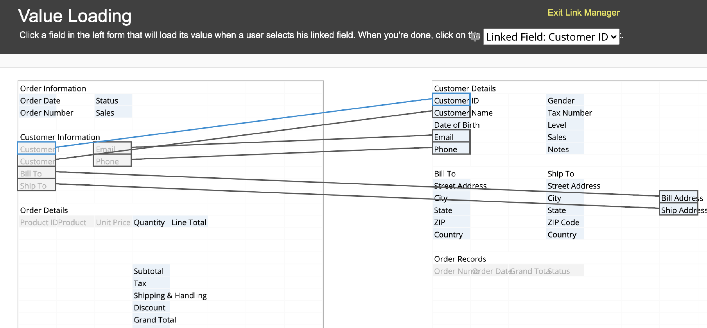
Build Relations Between Sheets
Businesses need a database system, not just a few tables

Slide 23
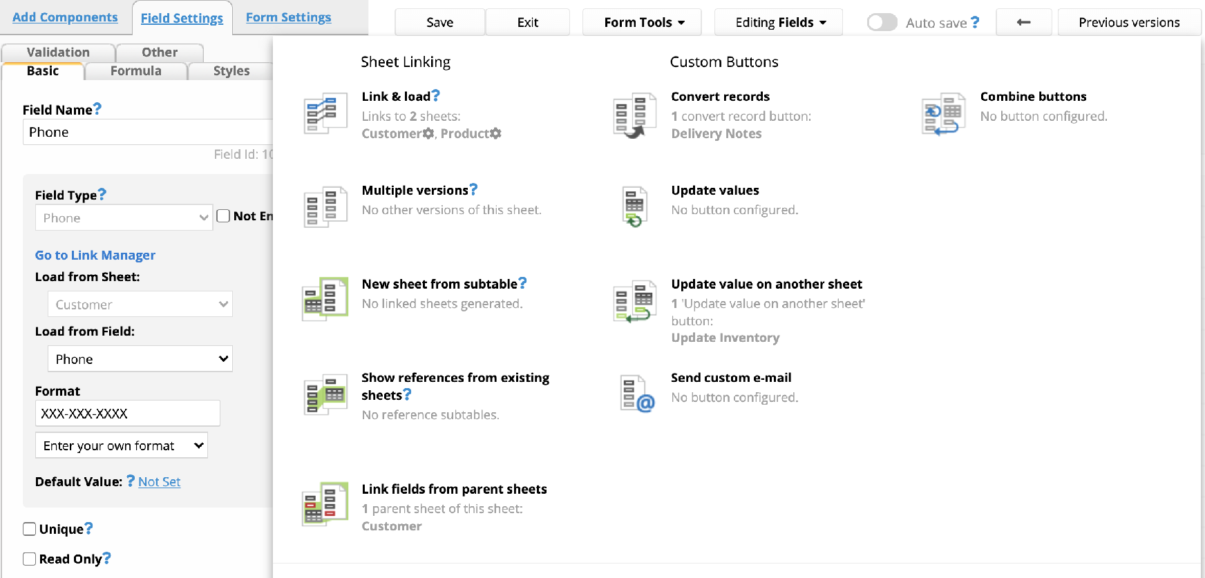
Custom Buttons
Add frequently used tools as custom buttons

Slide 24
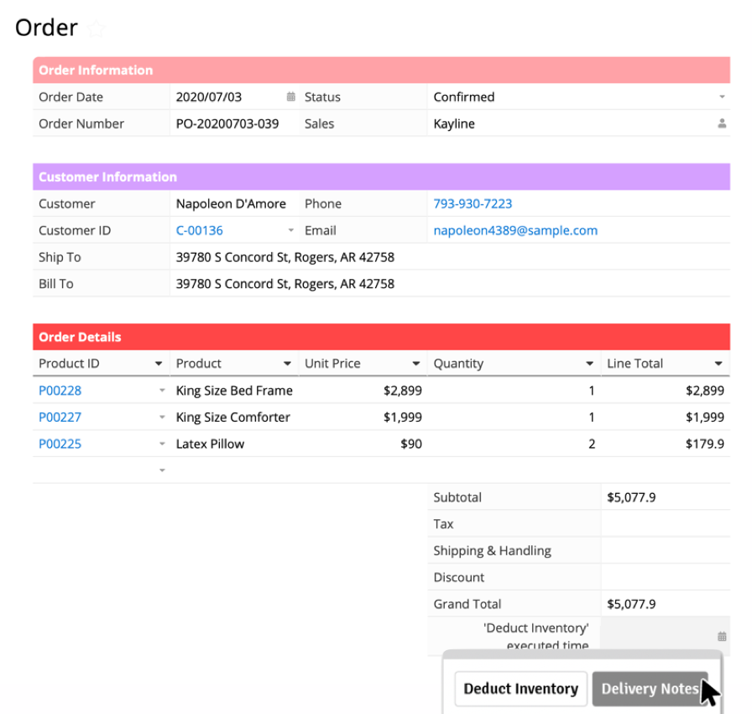
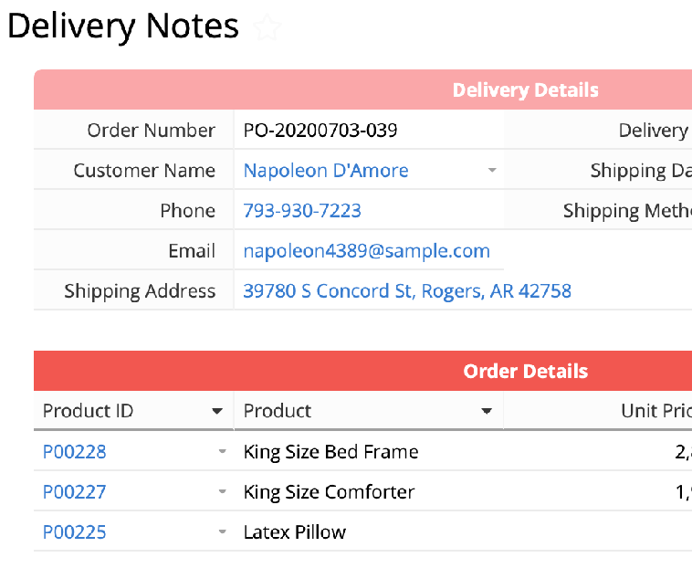
Action Buttons: Convert Records
Convert an order into a delivery note

Slide 25
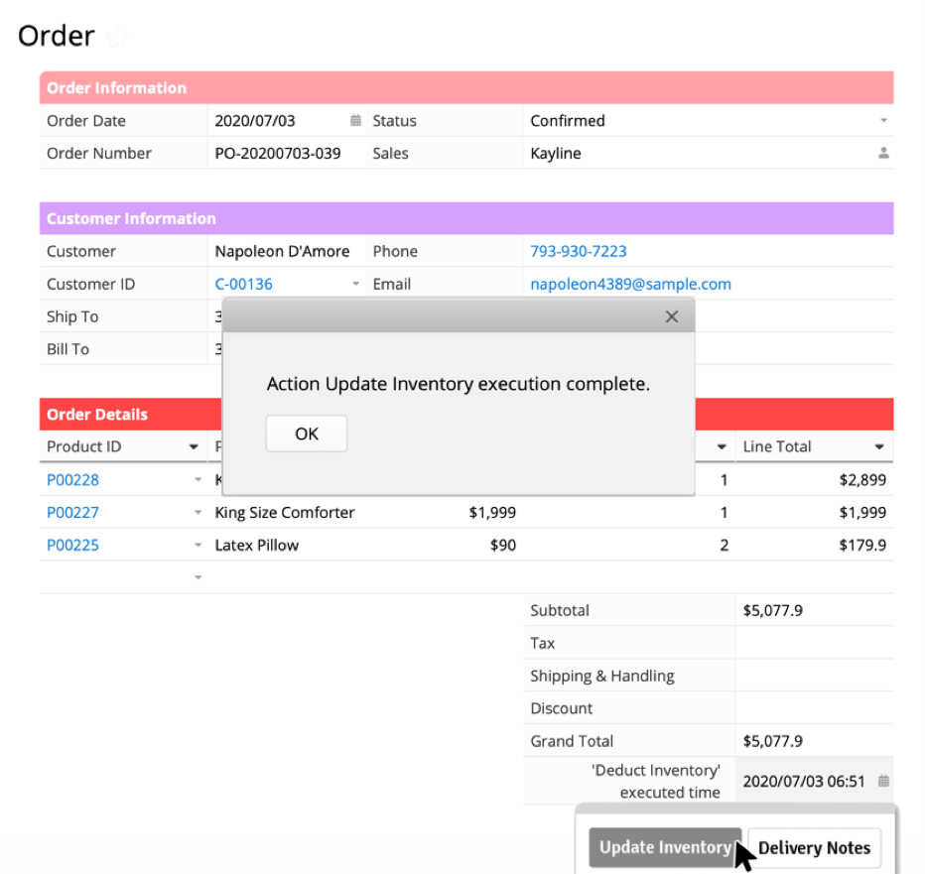
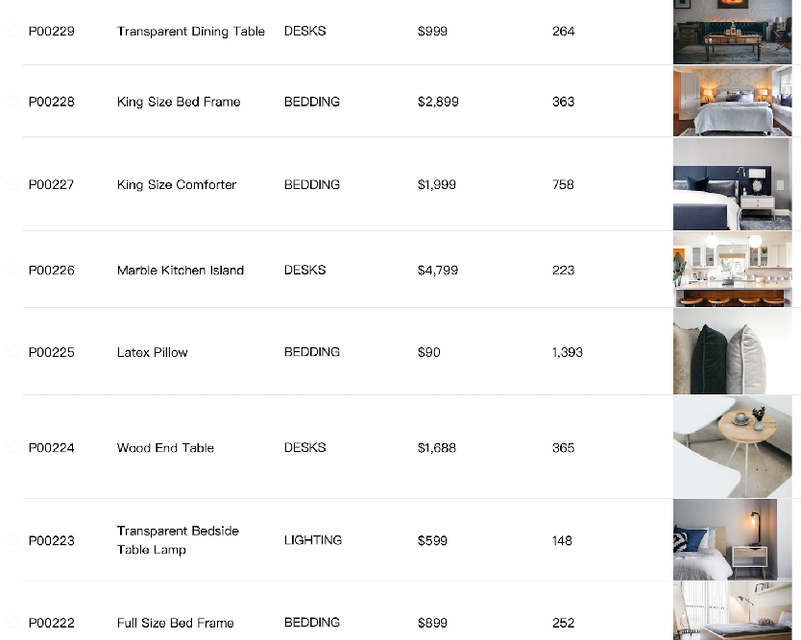
Action Buttons: Update Values
Update the inventory balance with one click

Slide 26
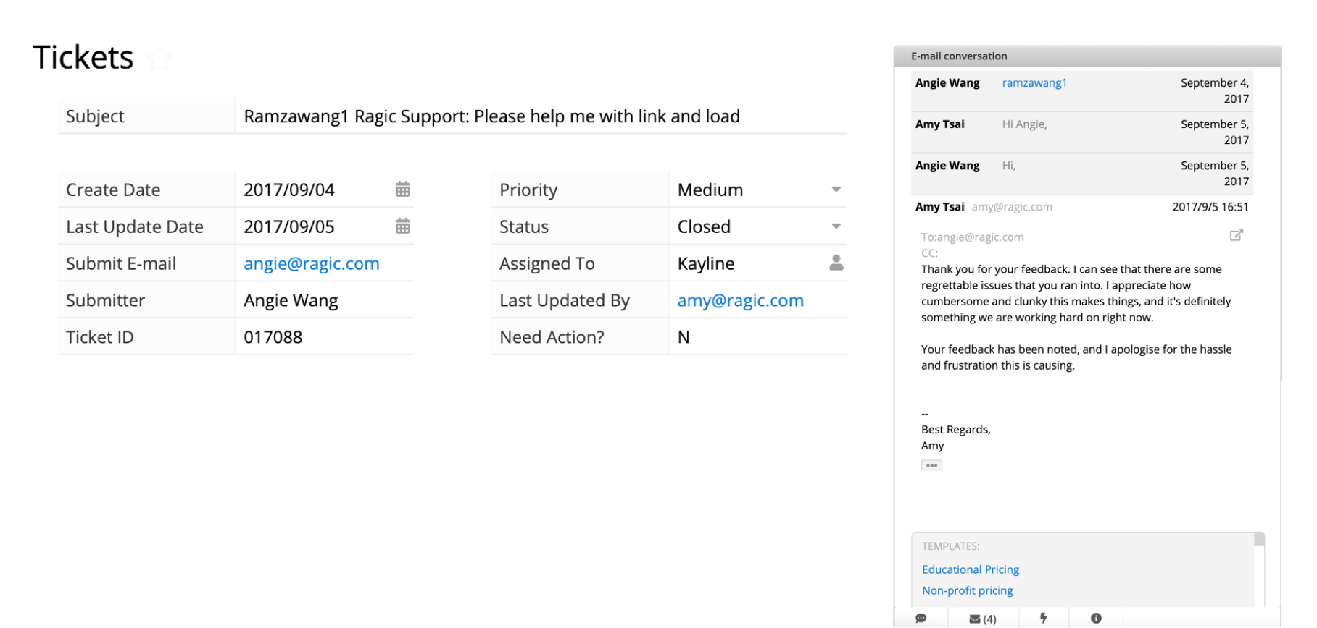
Emailing With the Database
Sending, receiving, and replying emails all in Ragic,
the easier way to follow up

Slide 27
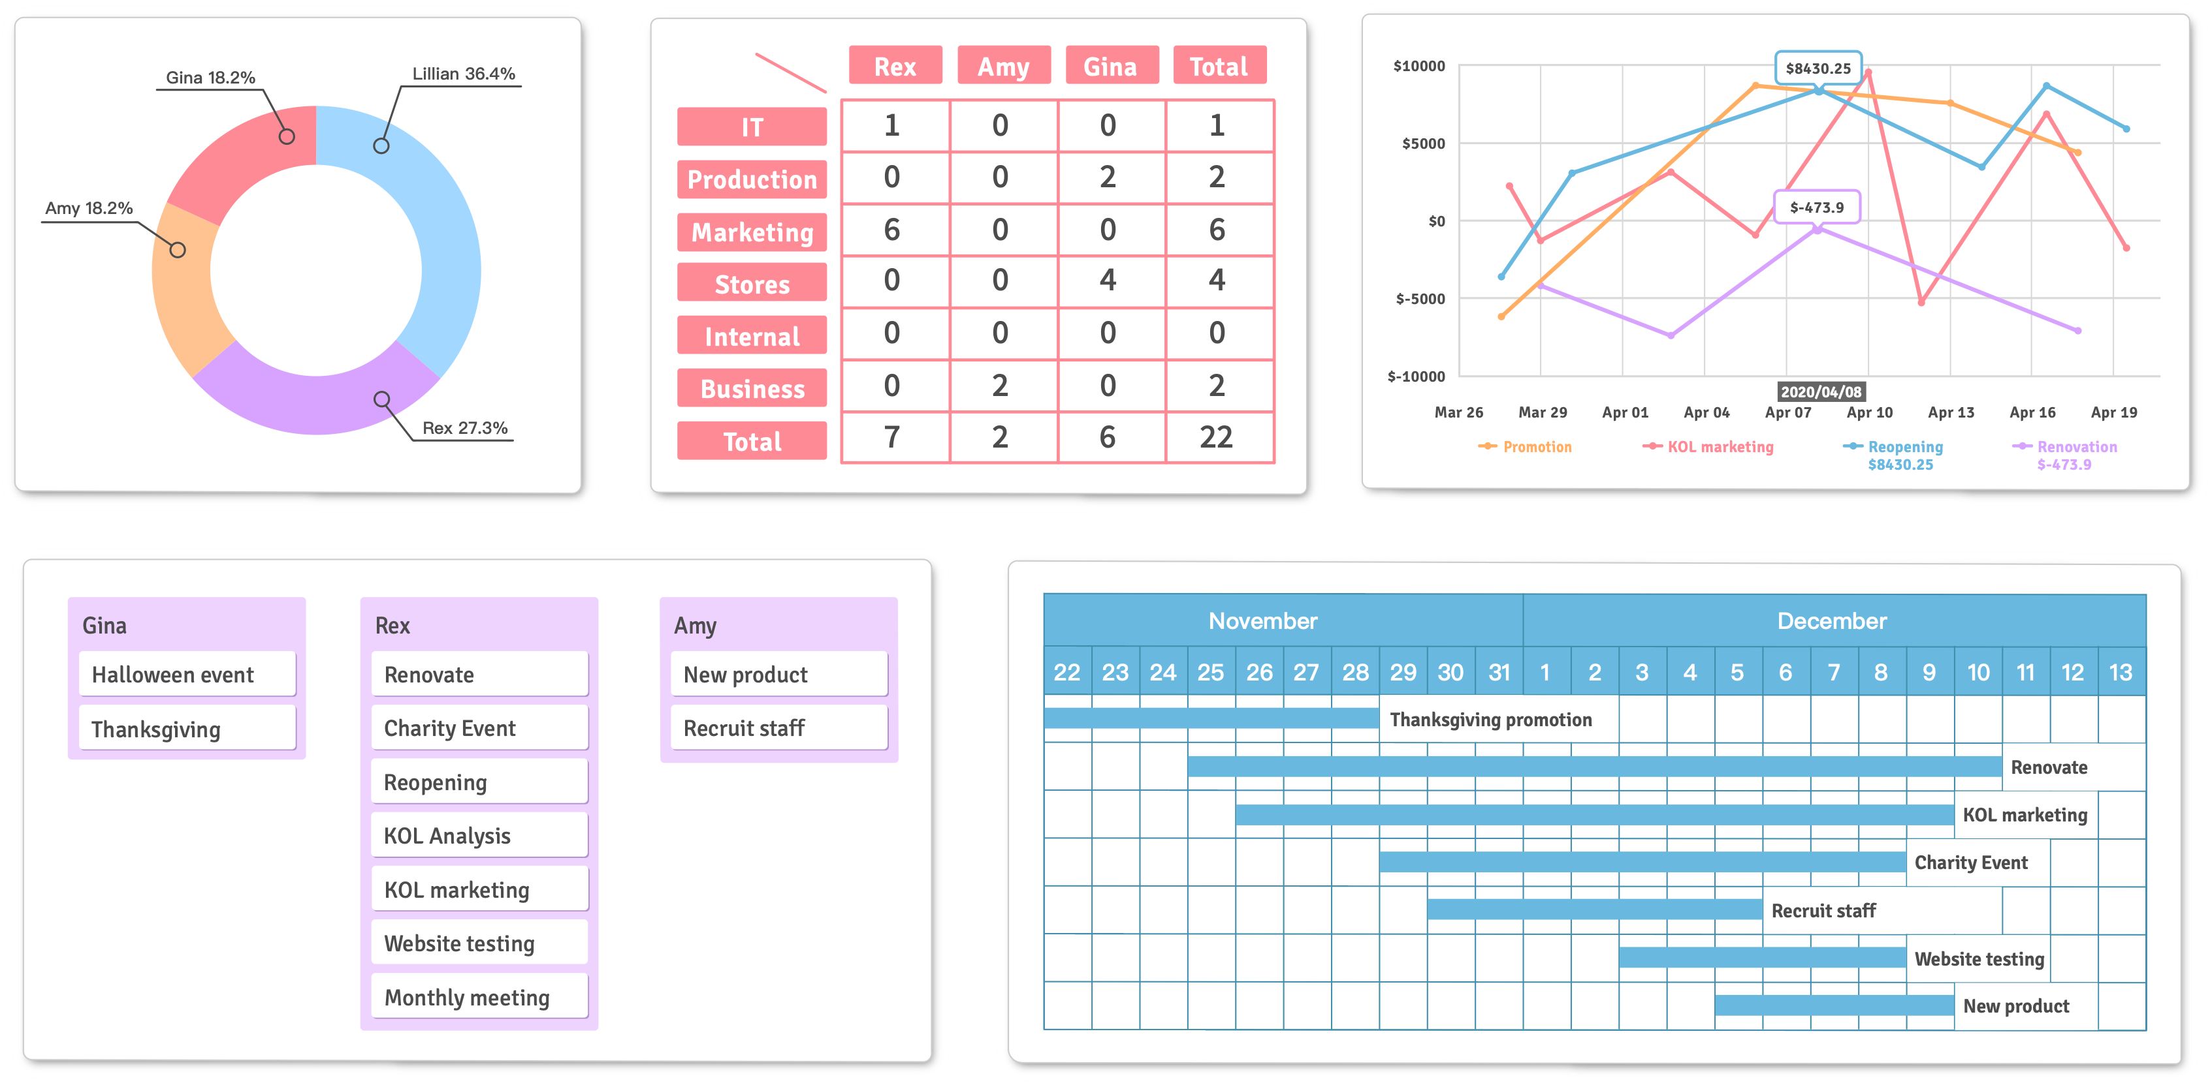
Reports
Crystal-clear visualization of your data with auto-generated reports

Slide 28
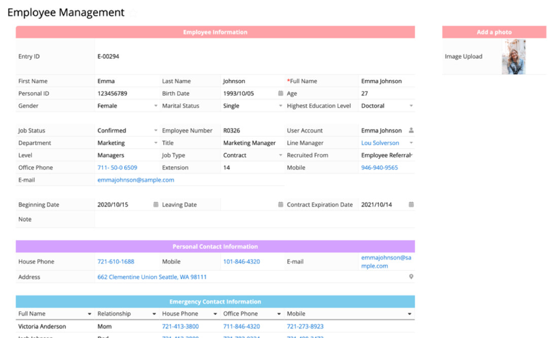
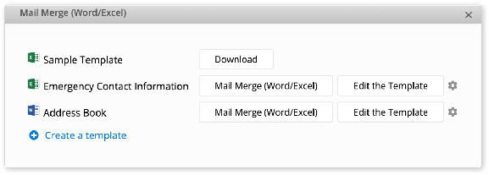
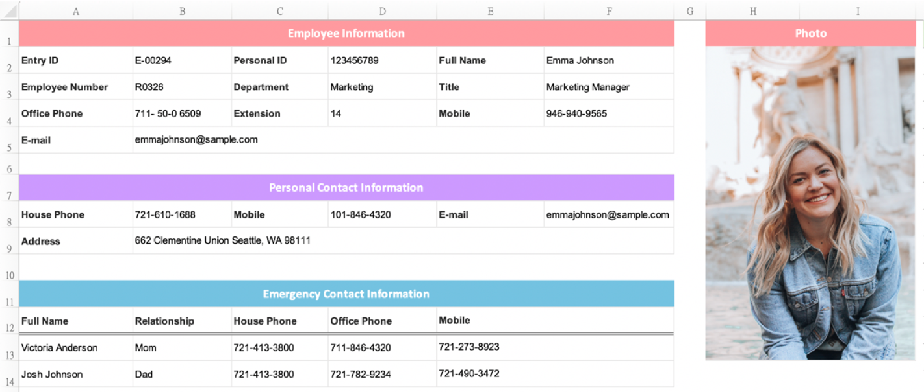
Generate Office Documents
Generate Word and Excel documents
automatically from your database with Mail Merge

Slide 29
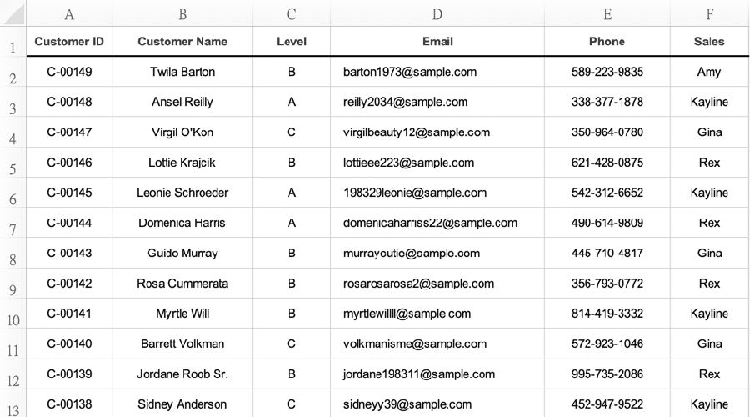
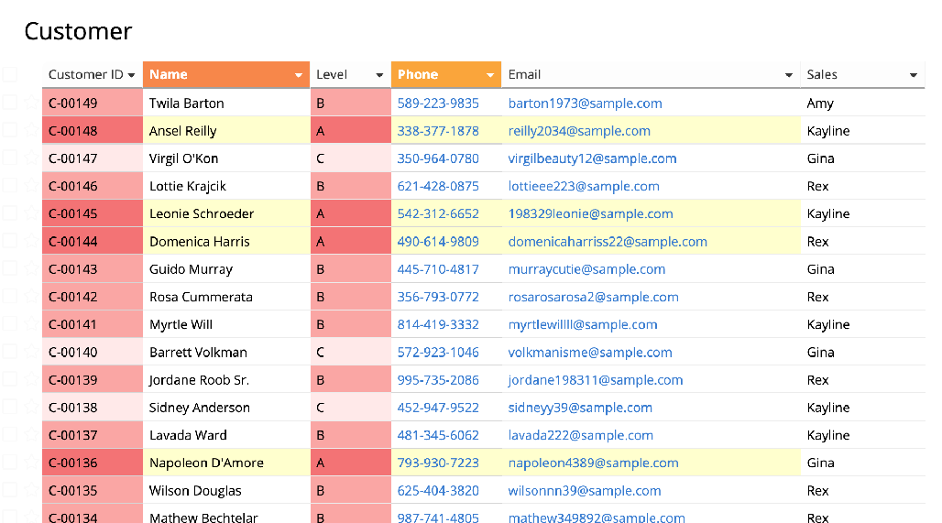
Works With Excel
Create databases with Excel files
Export Excel/CSV files

Slide 30
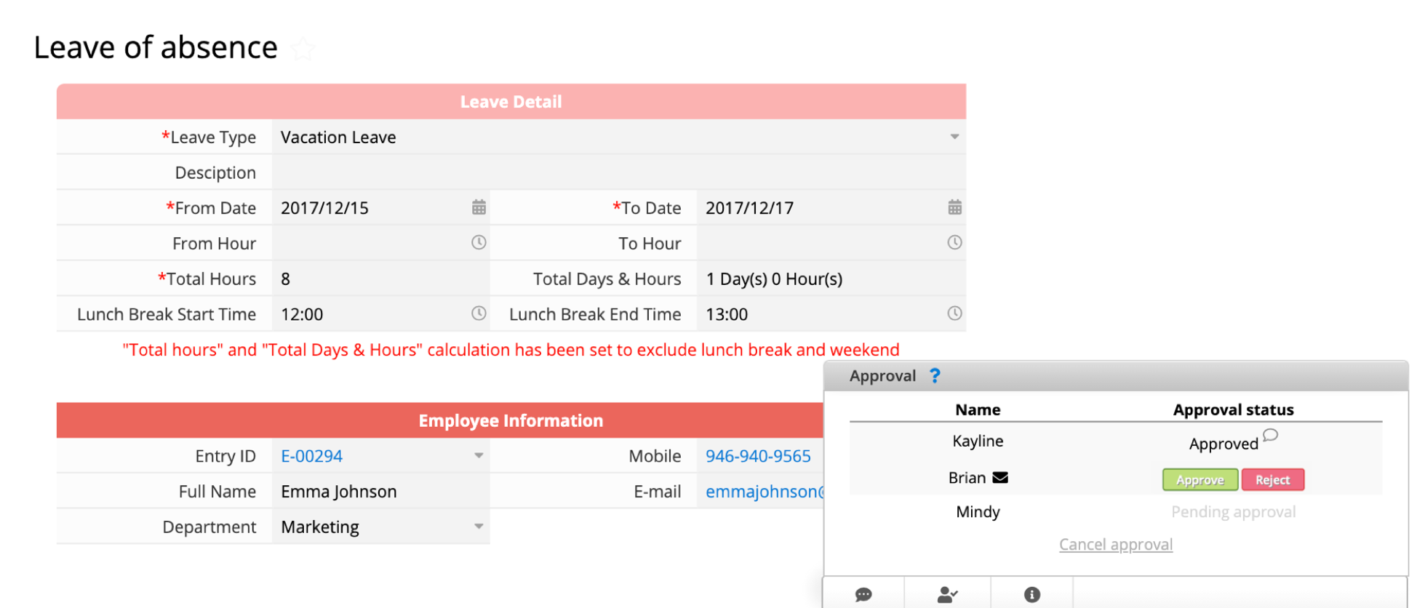
Built-in Approval Flow
Automated one-click approval system saves time for everyone

Slide 31
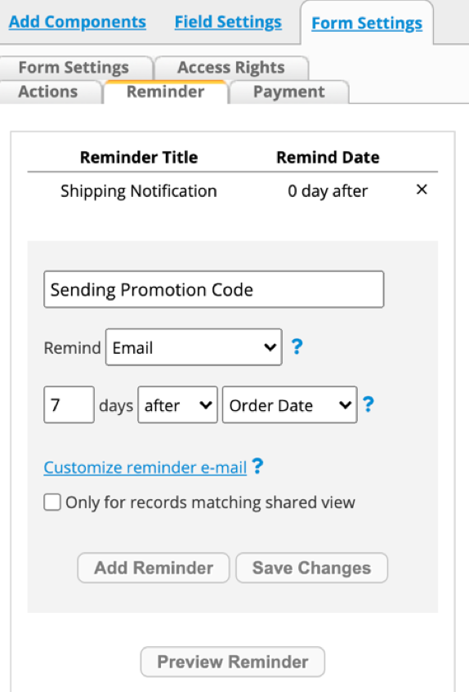
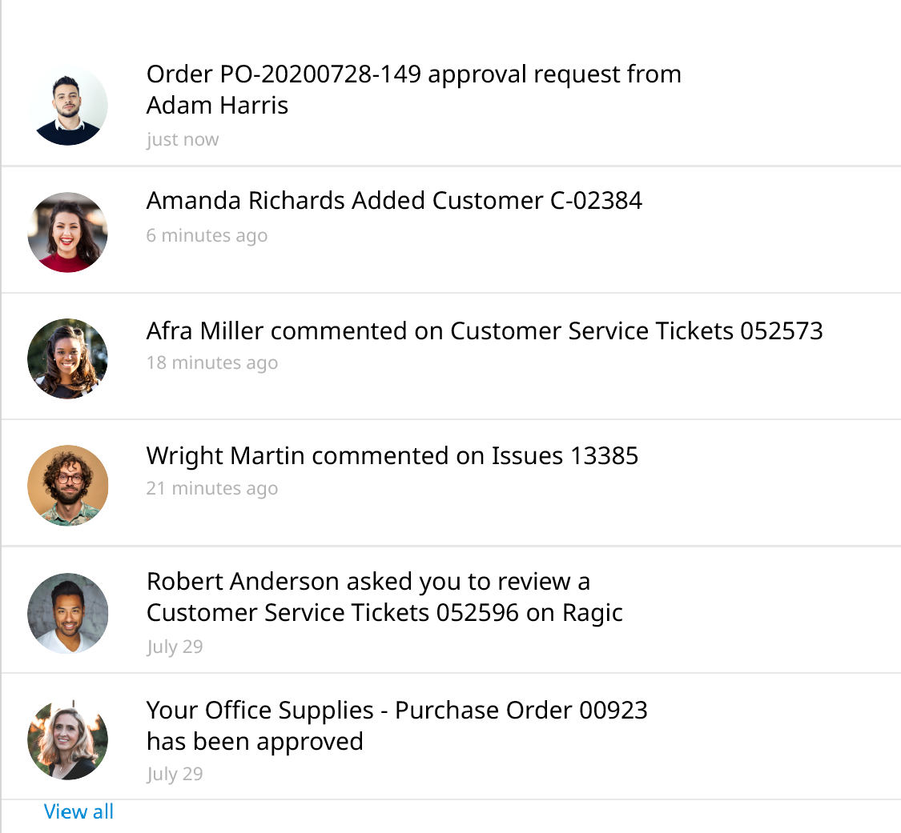
Reminders & Instant Notifications
Never miss out on the latest updates with emails,
on-screen reminders, and notifications

Slide 32
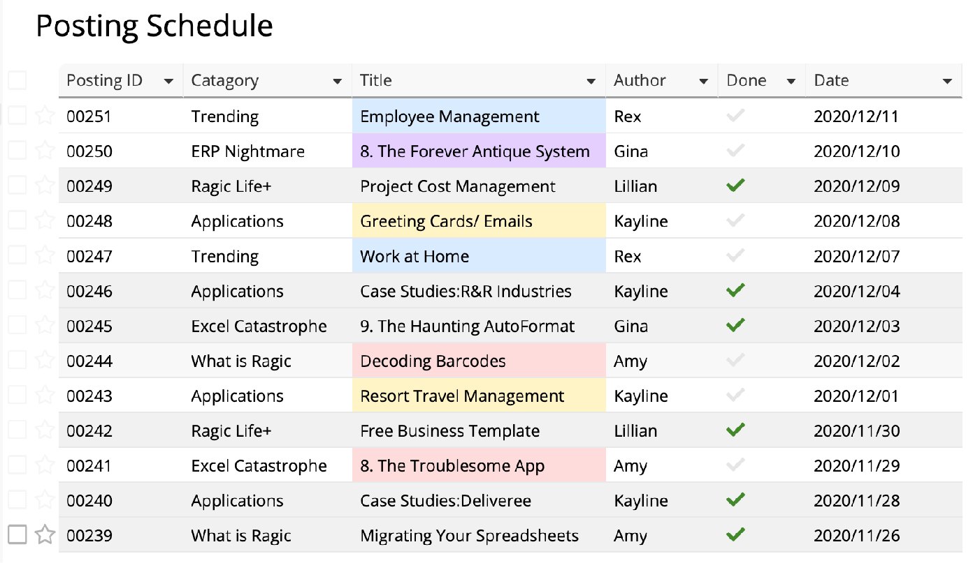
Calendar
Track all the dates in the database with
your favorite calendar application

Slide 33
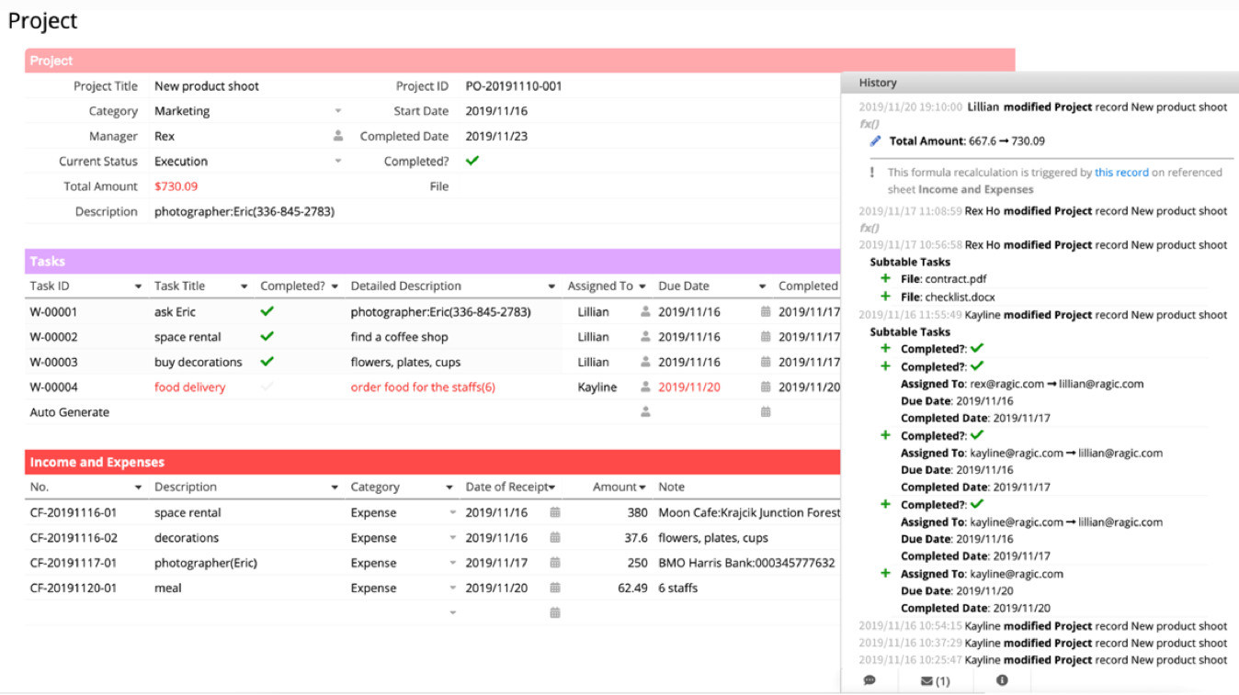



History
Who? When? What?
Full version history on how the entry has been modified
2019/11/20 19:10:00 Lillian modified
Project record New product shoot
  Total Amount: 667.6 → 730.09
!
  This formula recalculation is triggered
  by this record on referenced sheet
  Income and Expenses
2019/11/17 10:56:58 Rex Ho modified
Project record New product shoot
Subtable Tasks
  File: contract.pdf
  File: checklist.docx
2019/11/16 11:55:49 Kayline modified
Project record New product shoot
Subtable Tasks
  Completed?:

Slide 34
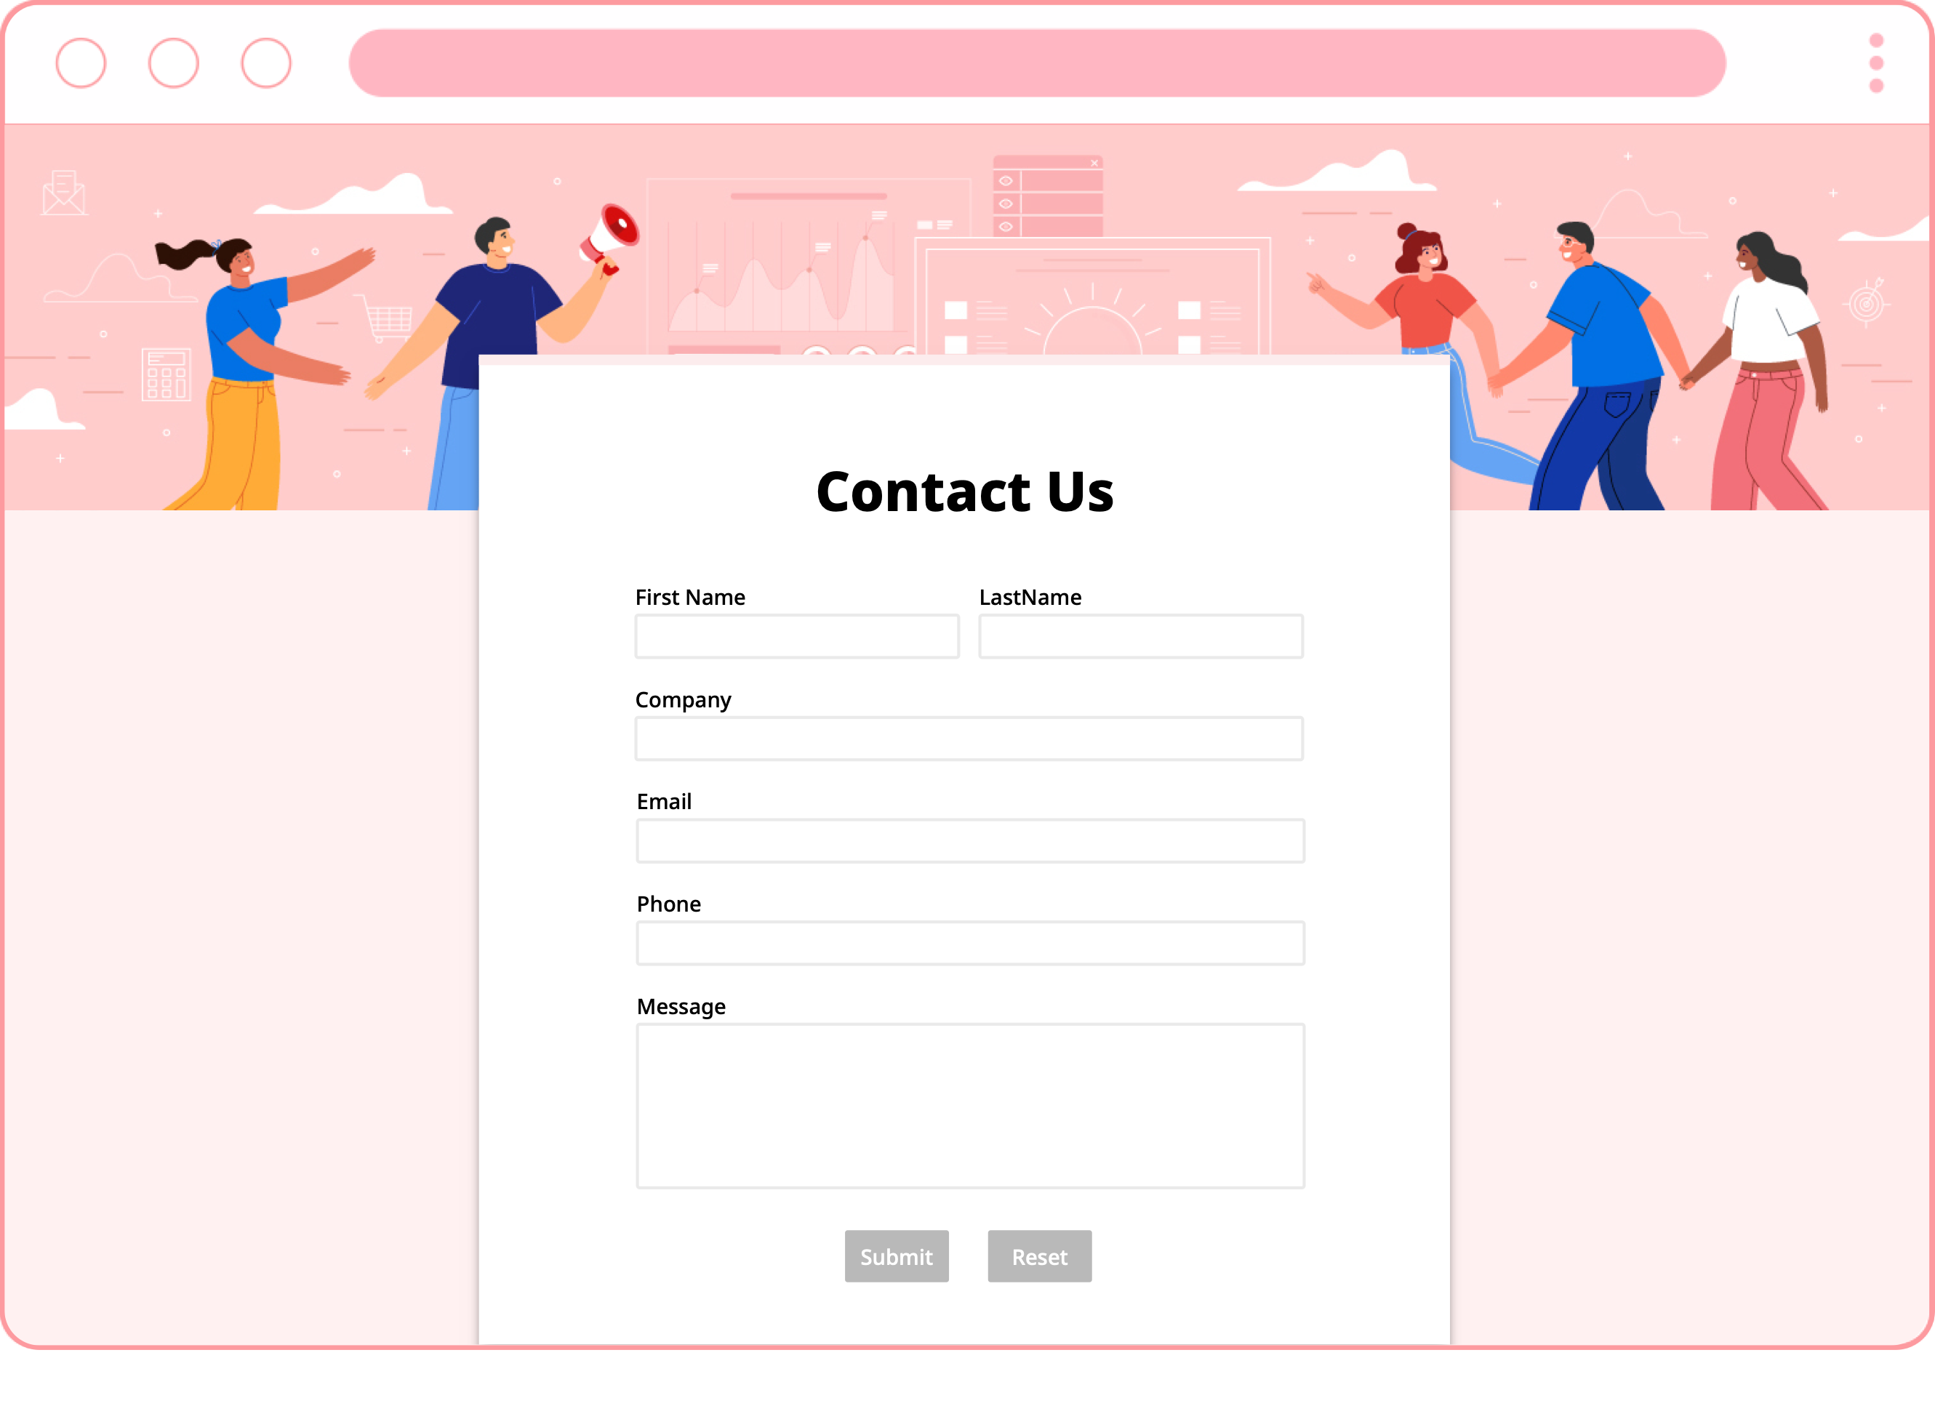
Embed on Your Website
Add the power of database to your web pages or blogs

Slide 35
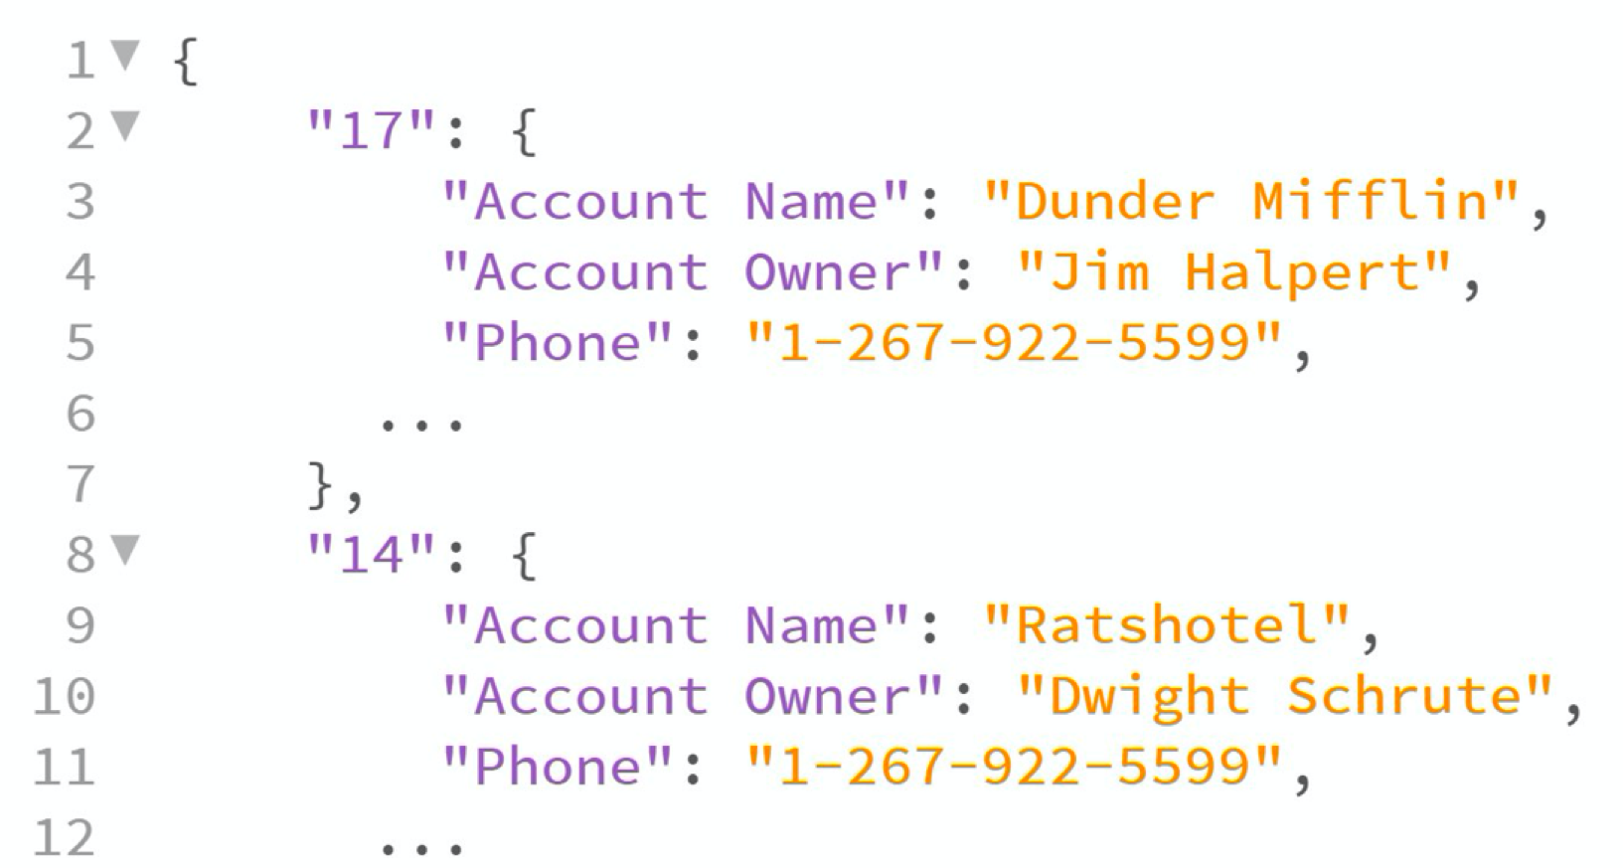
Simple, Powerful API
RESTful HTTP API for full programmatic access to your database

Slide 36
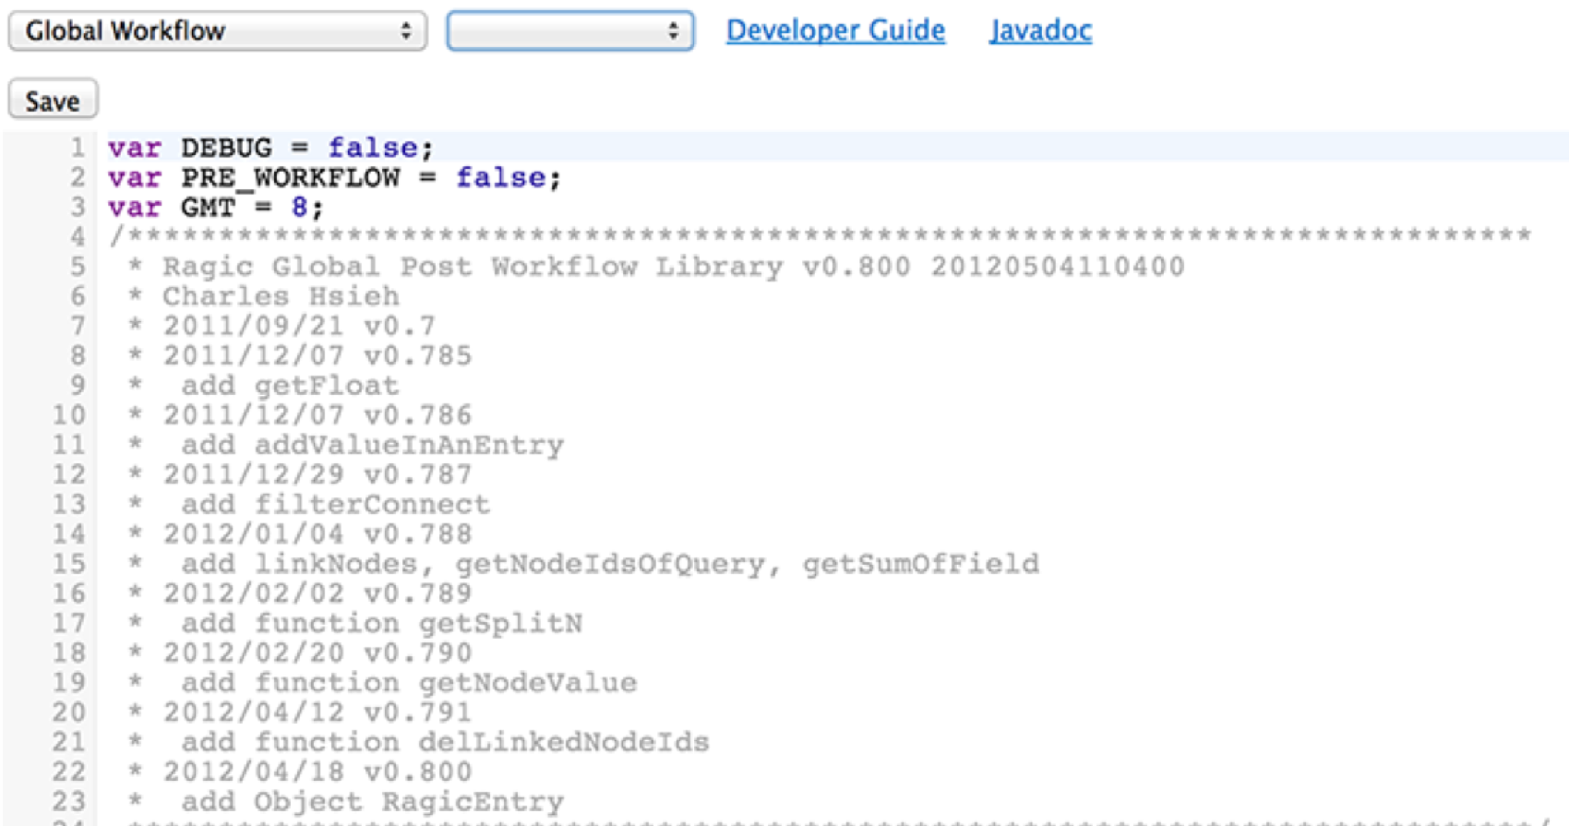
Customized Scripting
  No matter how complex your business logic is,
  it can be done with our server-side Javascript workflow engine

Slide 37
Technology Stack
Easy to deploy, cross-platform Java solution
Java-based
Deploy on Linux and Windows servers
Embedded application server (Jetty), embedded DB (Berkeley DB)
Super easy to install and deploy
NoSQL DB for high performance on flexible data structure
Server-side Javascript scripting engine
A language familiar to all web developers
Pure Javascript AJAX interface, no Flash/Applet/Silverlight, runs on any Web browser
Robust RESTful API to query / post data to Ragic

Slide 38

Happy Customers

